Slide 1
TouchDesigner to Shiftr
Subscribe Only

Slide 2
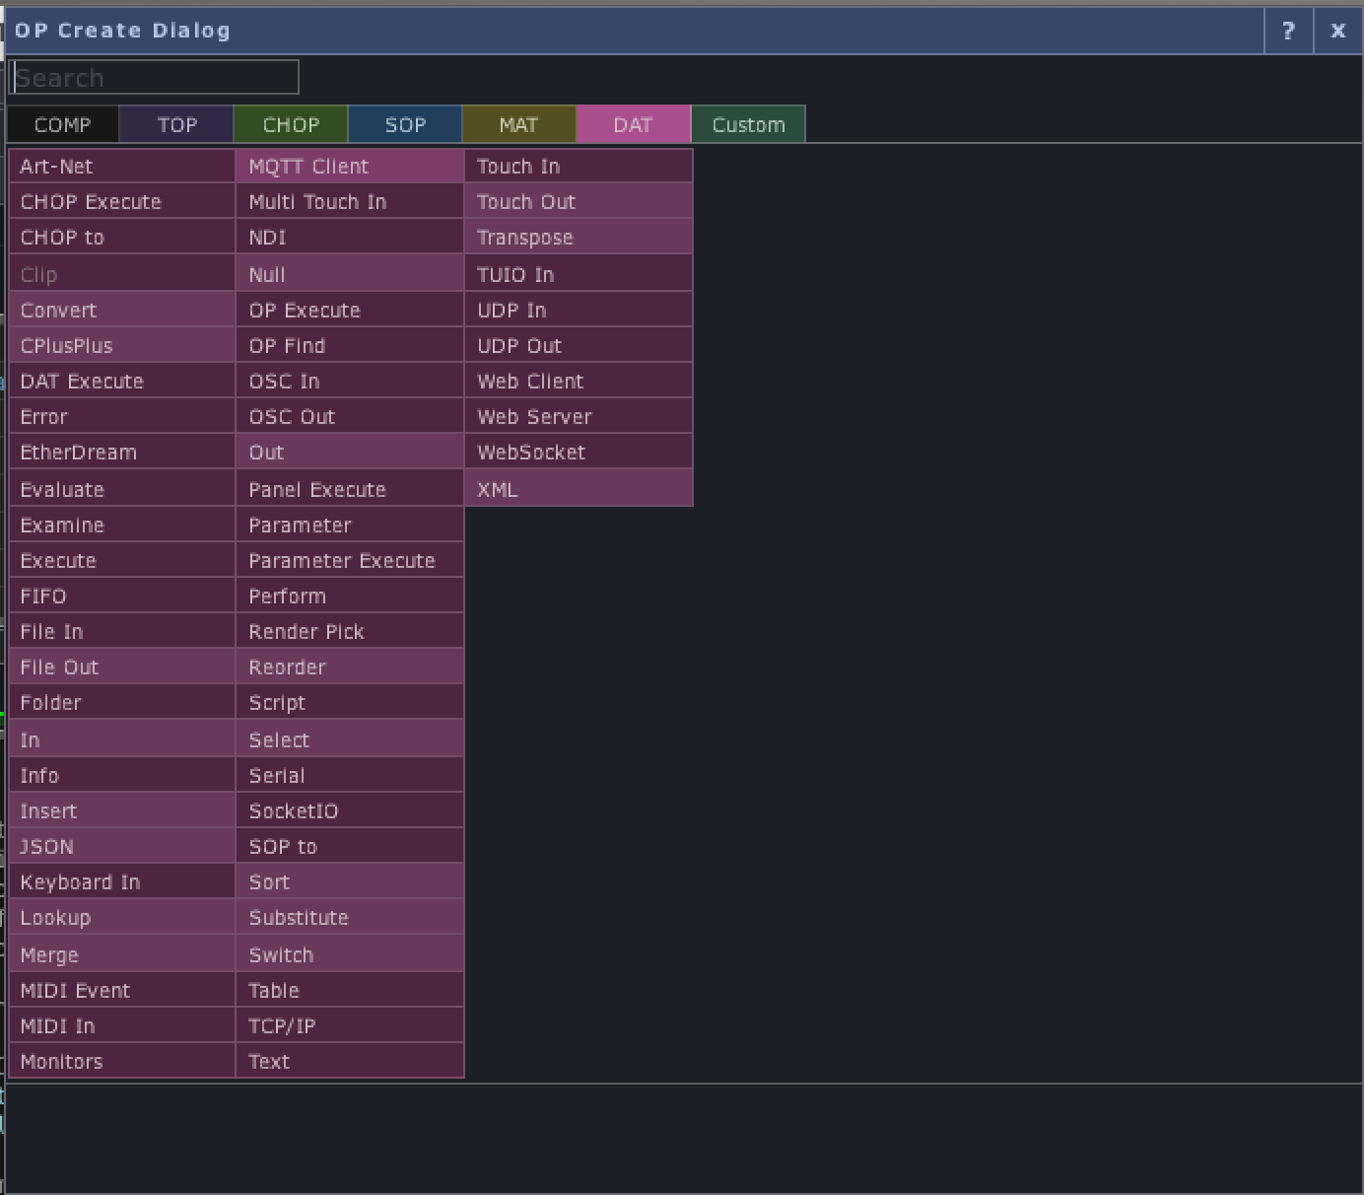
Step 1: DAT > MQTT Client

Slide 3
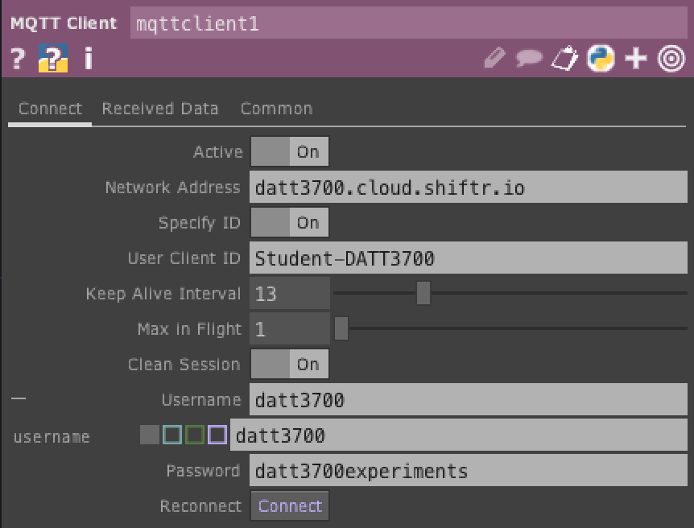
Step 2: add your credentials > connect
Network Address: datt3700.cloud.shiftr.io
ClientID – Your ID
Username: datt3700
Token Secret: datt3700experiments
You should see yourself in the shiftr.

Slide 4
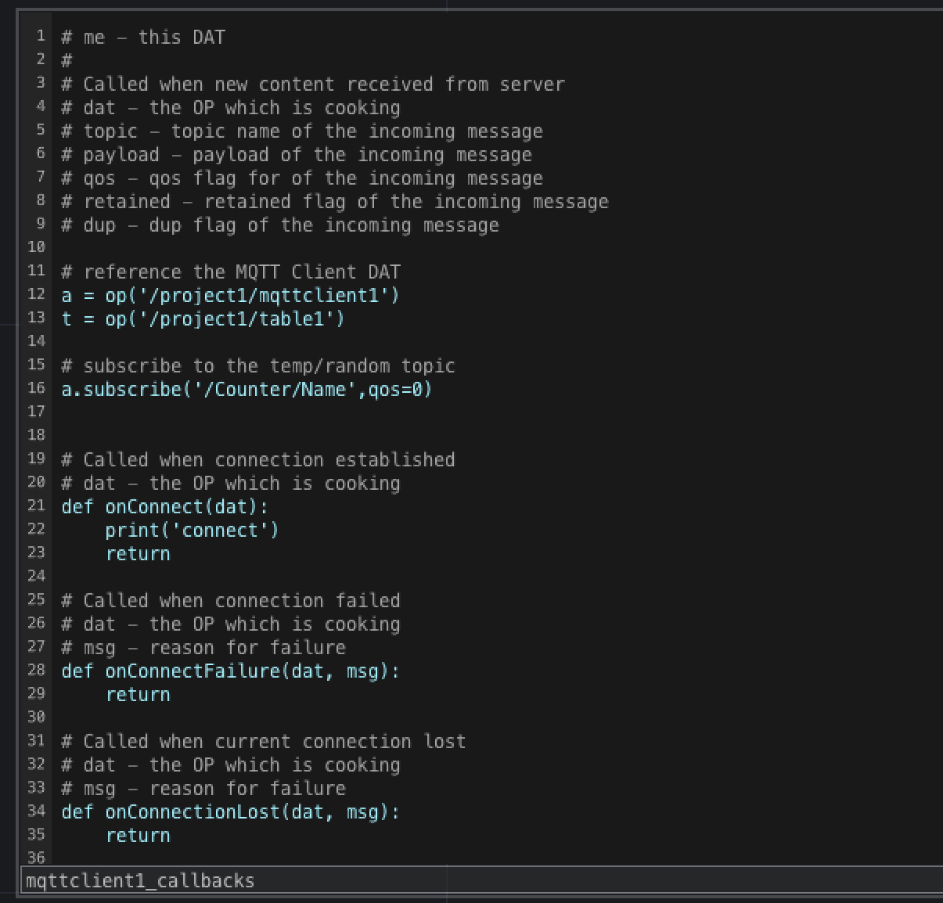
Step 3: Subscribe
# reference the MQTT Client DAT
a = op('/project1/mqttclient1')
t = op('/project1/table1')
# subscribe to the temp/random topic
a.subscribe('/Counter/Name',qos=0)
# Called when connection established
# dat - the OP which is cooking
def onConnect(dat):
print('connect')
return

Slide 5
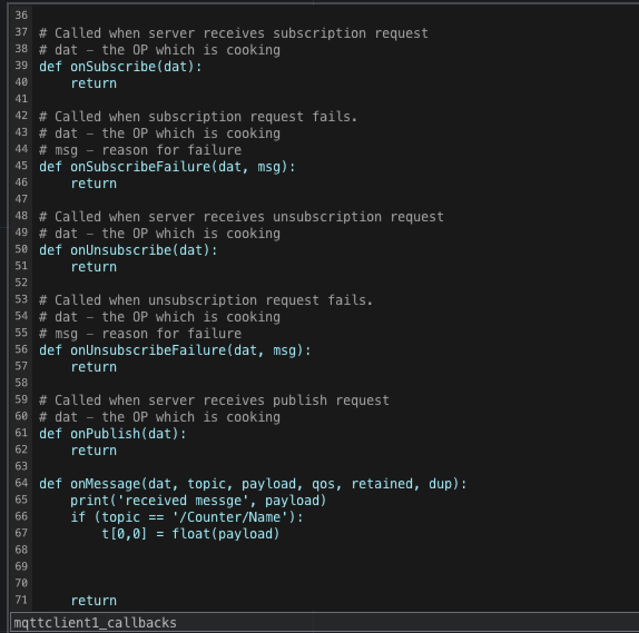
def onMessage(dat, topic, payload, qos, retained, dup):
print('received messge', payload)
if (topic == '/Counter/Name'):
t[0,0] = float(payload)

Slide 6
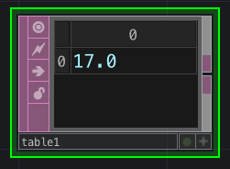
Step 4: Add a table DAT
If you have more than one value you will need a select

Slide 7
Walk through
https://datt3700.cloud.shiftr.io/

Slide 8
